Slide 1
Digital Portfolio
STUDENT NAME: manikandan
REGISTER NO AND NMId:61DF219A5C2A7C8A0EF422EEC9A23A32
DEPARTMENT: BSC cs
COLLEGE: COLLEGE/ UNIVERSITY: Srimath Sivaganga Balaya Swamigal tamil arts, science college, mailam./Annamalai university

Slide 2
PROJECT TITLE
Student digital portfolio

Slide 3


AGENDA
Problem Statement
Project Overview
End Users
Tools and Technologies
Portfolio design and Layout
Features and Functionality
Results and Screenshots
Conclusion
Github Link
3/21/2024 Annual Review

Slide 4

PROBLEM STATEMENT
In today's digital era, traditional resumes alone are not enough to showcase skills and projects effectively. Many students and professionals lack a structured online presence to highlight their work. A digital portfolio provides an interactive and accessible platform to present achievements, skills, and experiences.

Slide 5

PROJECT OVERVIEW
Brief summary of your project.
This is a personal portfolio website by Manikandan ,
Created a variety of professional and creative designs, including elegant wedding invitations, eye-catching college event pamphlets, and unique business visiting cards, focusing on vibrant visuals, effective communication, and memorable brand identity.

Slide 6

WHO ARE THE END USERS?
Students (academic projects, resumes).
Job seekers (to share with recruiters). Freelancers (to show clients).
Professionals (to highlight experience and achievements).

Slide 7

TOOLS AND TECHNIQUES
HTML Structure (pages, sections).
CSS Styling (colors, layouts, responsiveness).
JavaScript Interactivity (navigation menu, animations, form validation).
Mention code editor (VS Code) or CODEPEN and hosting platform (GitHub Pages),

Slide 8
POTFOLIO DESIGN AND LAYOUT
🔹 Sections in Your Portfolio:
️ 📌 Header / Navbar Section
"MyPortfolio"
Navigation links: About, Skills, Projects, Contact.
8

Slide 9
📌 Profile Section
Profile Picture (circular, floating animation)
Name: mani
Profession: Photoshop Designer & Creative Artist
Short tagline: “Creative Designs & Branding”
Button: View My Work (scroll to projects)

Slide 10
📌 About Section
Paragraph:
> “I'm a passionate Photoshop designer creating elegant wedding invitations, colorful college pamphlets, and professional business cards. My focus is on delivering unique, eye-catching designs with attention to detail.”

Slide 11
📌 Skills Section
Photoshop – Editing, posters, invitations
Creative Design – Visual compositions, layouts
Brand Identity – Business cards, logos, branding
(Optional) Illustrator, Canva/Figma

Slide 12
📌 Projects Section
Overview:
> “Created creative designs including wedding invitations, college pamphlets, and business visiting cards, showcasing professional visuals and brand identity.”

Slide 13
Projects: 🚀
1. Marriage Design – Elegant wedding invitations & posters
2. College Pamphlet – Colorful college event pamphlets
3. Visiting Card – Professional & unique business card designs

Slide 14
📌Contact Section
Form Fields: Name, Email, Message
Submit Button: Gradient, click animation
Success Message: “Successfully Submitted” appears after submit, auto-hides after few seconds

Slide 15
📌 Footer
© 2025 mani's Portfolio
Optional: Social Media Icons (LinkedIn, Instagram)

Slide 16
FEATURES AND FUNCTIONALITY
📌 Modern, responsive design for all devices
📌 Floating profile picture & smooth animations
📌 Skills cards with hover effects
📌 Projects showcase (Marriage, College Pamphlet, Visiting Card) with zoom effect
📌 Interactive contact form with success message
📌 Footer with copyright & social links

Slide 17
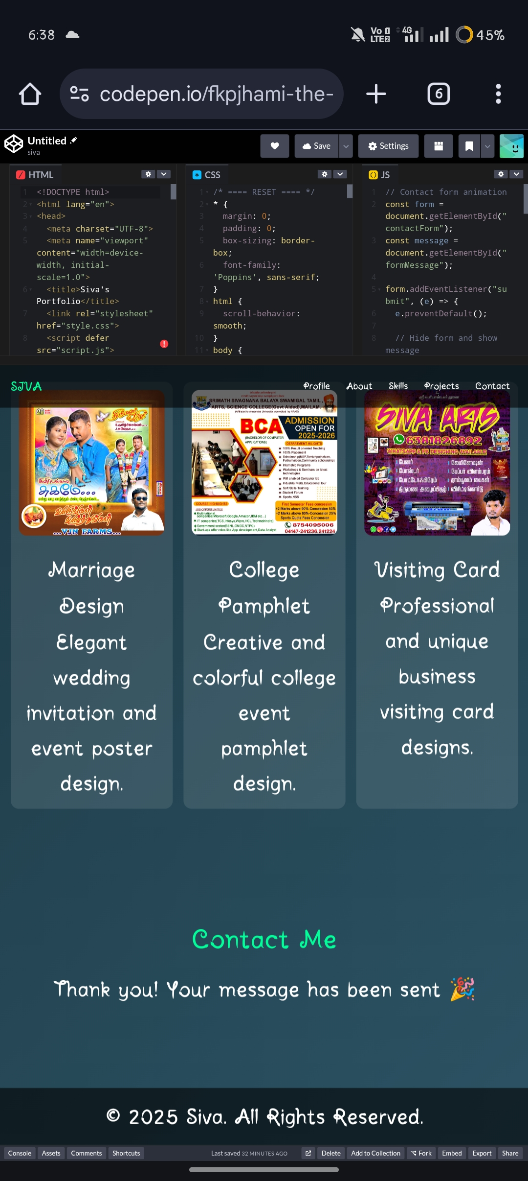

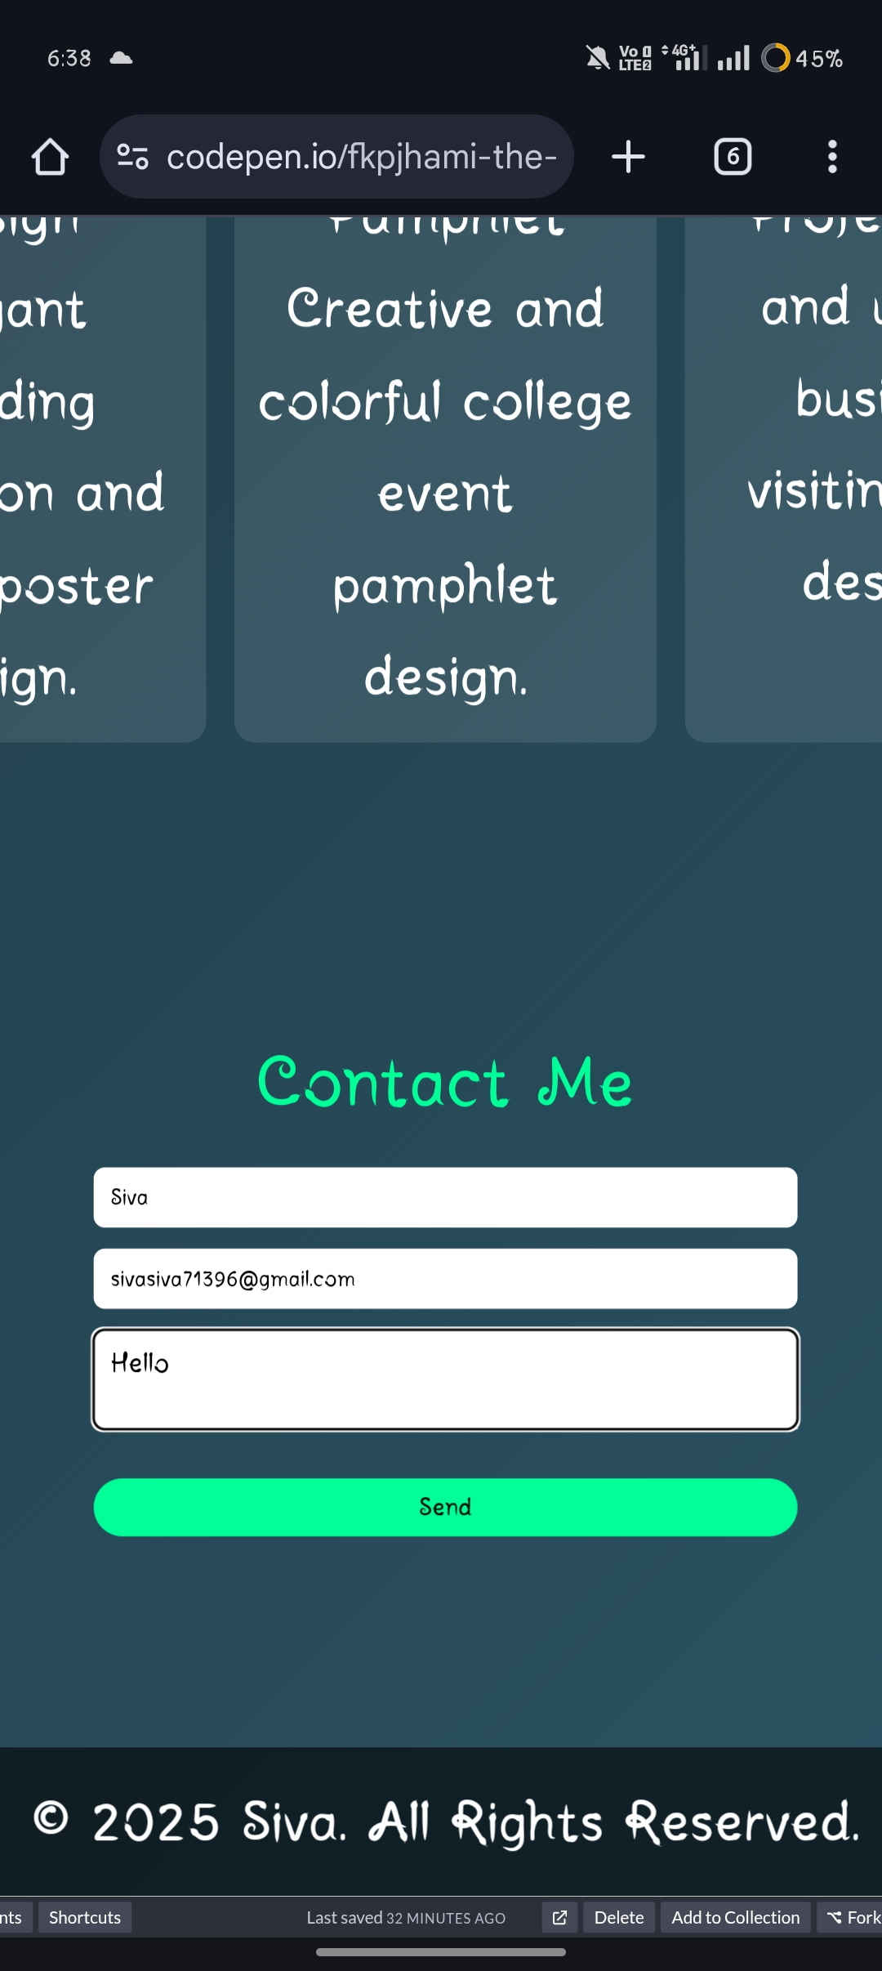
RESULTS AND SCREENSHOTS
•Screenshots of each section
•Before vs After (plain HTML with CSS & JS).
3/21/2024 Annual Review
17

Slide 18
CONCLUSION
? Portfolio Project Highlights
1️⃣
🔥 Portfolio Project Highlights
📌 Modern & responsive design for all devices
📌 Smooth navigation and interactive sections
📌 Projects showcase with live visuals:
🔥 Marriage Design
🔥 College Pamphlet
🔥 Business Visiting Card
18

Slide 19
📌 Skills showcase: Photoshop, Creative Design, Brand Identity
📌 Interactive contact form with animated submission
📌 Engaging animations on buttons, project cards, and profile picture

Slide 20
🔥Final summary
This portfolio showcases my creativity and Photoshop skills through projects like wedding invitations, college pamphlets, and business cards, in an interactive, responsive, and visually appealing format.

Slide 21
🔥Benefits to society
📌 Provides professional design services for weddings, colleges, and businesses, making events and branding visually appealing.
📌 Helps small businesses and organizations communicate effectively through creative visuals.
📌 Inspires creativity and sets a standard for professional, well-designed materials.
📌 Makes information and invitations more engaging and easy to understand for the audience.

